Slide 1

CPS101
1
INTRODUCTORY COMPUTER TECHNOLOGY
3UNITS
SHITTU A.J.K (PhD)
Professor

Slide 2
Overview of Computers & Programming Languages
Chapter 1

Slide 3
Chapter Contents
Computer History
Elements of a Computer System
  Hardware
  Software
Language of a Computer
Evolution of Programming Languages
High Level Languages
Analysis-Coding-Execution
Object Oriented Programming

Slide 4
Computer History
1950's
  Large devices, accessible to few people
1960's
  Commercial usage emerges
  Operated by experts
1970's
  Computers cheaper, smaller
1990's
  Computers fast, small, inexpensive
  Owned and used by many people

Slide 5
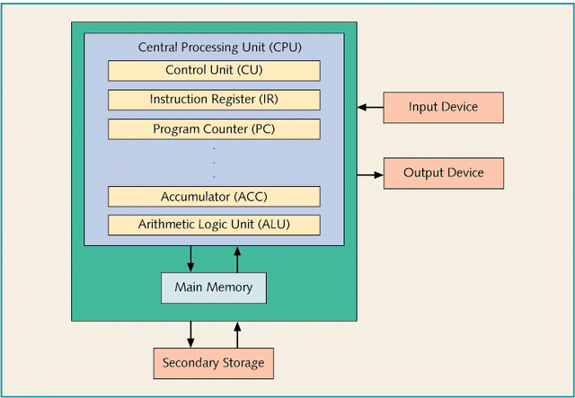
Elements of a Computer System
Hardware
CPU
The "brain" of the computer
Keyboard
Disk drive
Scanner
Mouse
Screen
Printer
Plotter
Hard drive
Zip-Disk
CD-Rom
Tape Backup
Main Memory
Data and instructions stored to, fetched from

Slide 6
Elements of a Computer System
Software
Systems programs
  Control the computer
  Includes Operating System
Applications programs
  Word processors
  Compilers
  Spreadsheets
  Data Bases

Slide 7
The Language of a Computer
Uses digital signals
  all 0's and 1's (binary)
  bits (BInary digiTs)
Data and commands stored in binary
  8 bits in a byte
  ASCII character stored in a byte
  Integers stored in 2 or 4 bytes

Slide 8
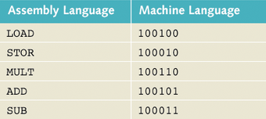
Evolution of Programming Languages
Early computers programmed in machine languages
  All binary numbers
Assembly language used mnemonic codes
  Codes translated
  into machine
  language by a
  program called
  the "assembler"

Slide 9
Evolution of Programming Languages
High level languages read like combination of English and algebra
  Translated into machine language by a program called a compiler
write_string (outfile,cust_name,'l',23);
first_line = 1;
ord.read_order(infile);
while (!ord.done())
{
if ( !first_line) write_string (outfile," ",'l',23);
ord.print_order (outfile,part_list);
first_line = 0;
ord.read_order(infile);
}

Slide 10
Processing a High-Level Language Program
Source program created with an editor
Source code translated into machine language by compiler
  results in a .obj file (object code)
Linker combines common library routines with object code
  Results in a .exe file (executable code)
Loader brings executable code into memory and it is run

Slide 11
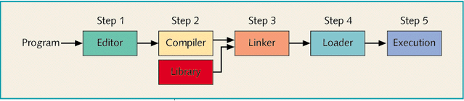
Processing a High-Level Language Program

Slide 12
Analysis-Coding-Execution
Algorithm :
A step-by-step problem-solving process in which a solution is arrived at in a finite amount of time
  Steps must be simple, unambiguous
  Steps must be performed in specified order
  Steps must solve the problem

Slide 13
Analysis-Coding-Execution
Problem solving process
Analyze problem, design solution algorithm
Implement algorithm in a programming language, verify
Maintain program, adapting it to changes in problem requirements

Slide 14
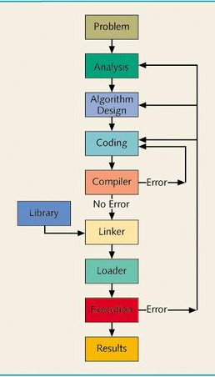
Analysis-Coding-Execution
Analysis and algorithm design done apart from any specific programming language
Processing of the high-level language programming language

Slide 15
Structured Programming
Thoroughly understand the problem
Determine
  the output desired
  the required input
  processing that will occur
Divide the problem into sub-problems
Other names for this process
  structured design
  top-down design
  stepwise refinement
  modular programming

Slide 16
Object-Oriented Programming
Identify components of the problem which are objects
  Usually these are the nouns in the program description
Identify operations which are performed on the objects
  Often these are the verbs in the program description

